Slide 1



MinersGO
Shreya Goyal
Anirudh Ganguly
Riddhi Jain
015251990
015268071
014600716

Slide 2

Abstract
Discovering the appropriate profile among the large number of candidates can be a very tedious task. This study focuses on resume retrieval based on indexing as a result of simple query from unstructured data. Ranking scores of resumes will be computed based on the keyword matching with the query. Then this result will be feed to the data-driven and content based filtering algorithms to obtain improvements in resume retrieval. After all this processing, top ranking resumes will be displayed.

Slide 3
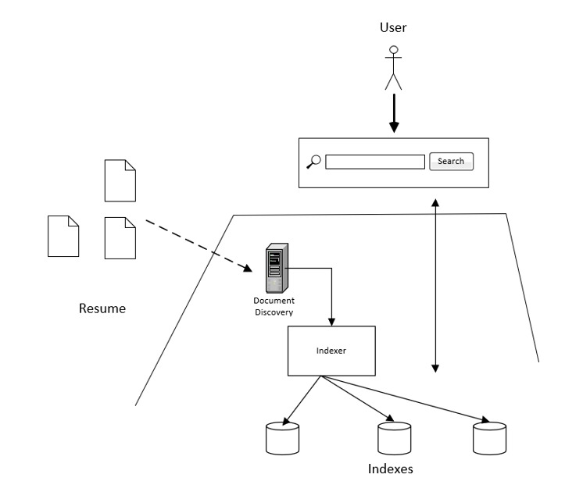
System Design
Key Components
Web Interface - This provides an interface to enter the query text
Document discovery - This service scans and discovers new resumes that are available to the system
Indexer - This performs preprocessing on the text in resume
Indexes - This is the processed data stored in the system

Slide 4
How it works
Step 3
Step 2
Step 1
Improve retrieval performance by clustering the resumes. Unsupervised clustering algorithms like KNN or hierarchical clustering can be used
Use information retrieval techniques to match each resume with the search query and return the highest ranking resumes
Preprocess the text and transform unstructured data to structured data

Slide 5
Milestones
#1
#3
#2
#4
Information Extraction
Sentence Breaking and Tagging
Apply machine learning algorithms
Improve the accuracy iteratively
10/03/2020 | 10/24/2020 | 11/14/2020 | 11/30/2020
Data cleaning
Unstructured to Structured Data
Visualizing features
Evaluate Model
Conclude and Summarize
Research Paper

